Slide 1
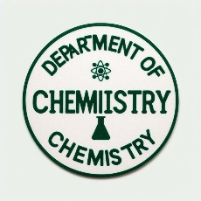

FEDERAL UNIVERSITY OF LAFIA DEPARTMENT OF CHEMISTRY
Course code: CHM102
Course Title: General Chemistry II
Course Unit: (2 Units)
Module 3: Nomenclature and functional group classes of organic compounds.

Slide 2
MODULE OBJECTIVES
Nomenclature
Importance of Nomenclature
Basic Principles of IUPAC Nomenclature
Common Functional Groups
Alkanes, Alkenes, and Alkynes
Aromatic Compounds
Alcohols and Ethers
Aldehydes and Ketones
Carboxylic Acids and Esters

Slide 3
Importance of Nomenclature
- Accurate naming is essential for effective communication among scientists.
- The IUPAC (International Union of Pure and Applied Chemistry) system provides standardized rules for naming organic compounds.
- Proper nomenclature ensures clarity and consistency in scientific literature.

Slide 4
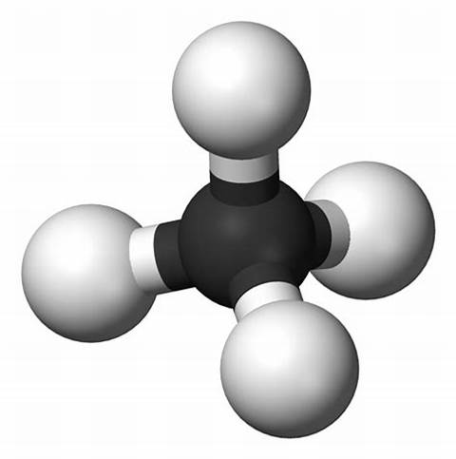
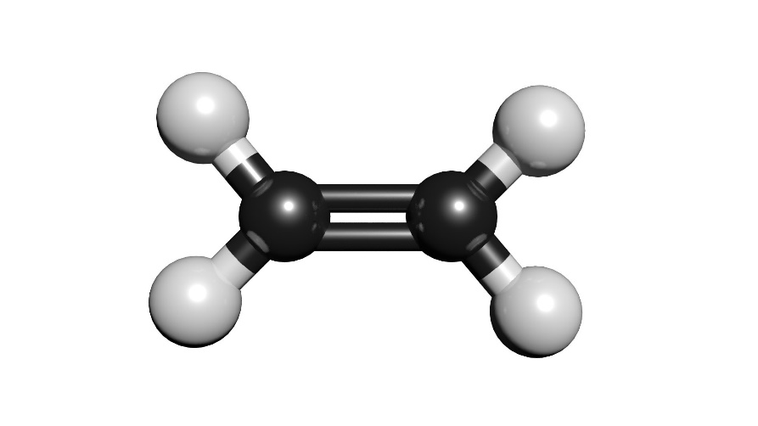
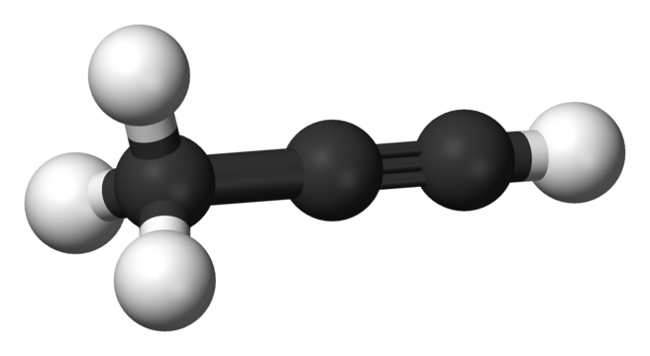
Basic Principles of IUPAC Nomenclature
- Naming alkanes, alkenes, and alkynes follows systematic rules.
- The root indicates the number of carbon atoms, the prefix denotes the type of bond, and the suffix indicates the nature of the compound.
- Examples: Methane, Ethene, Propyne.

Slide 5
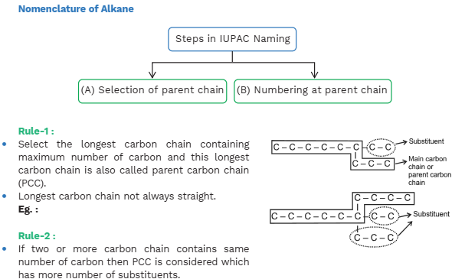
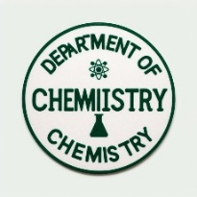

Slide 6
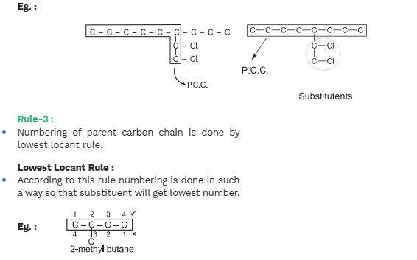

Slide 7
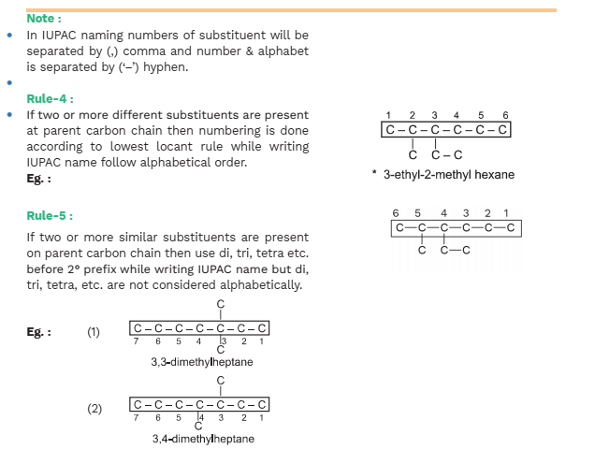

Slide 8
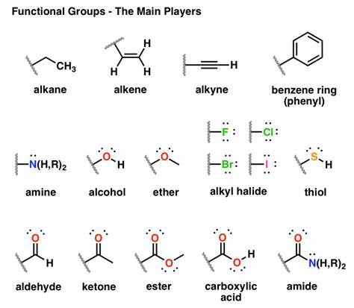
Common Functional Groups
- Functional groups are specific arrangements of atoms that determine the properties of organic compounds.
- Examples include hydroxyl (-OH), carbonyl (C=O), and amino (-NH2).

Slide 9
Alkanes, Alkenes, and Alkynes
- Alkanes are saturated hydrocarbons with single bonds.
- Alkenes contain at least one carbon-carbon double bond.
- Alkynes contain at least one carbon-carbon triple bond.
- Molecular structures and key characteristics illustrated

Slide 10
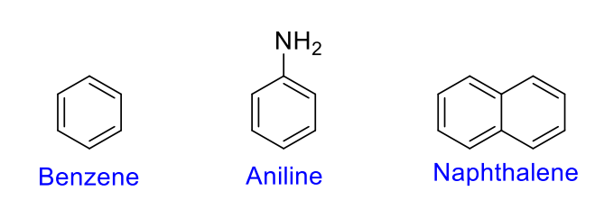
Aromatic Compounds
- Aromatic compounds contain a benzene ring (C6H6).
- Benzene exhibits resonance, making it stable and unique.
- Aromatics have distinct properties and are often found in fragrances and pharmaceuticals.

Slide 11
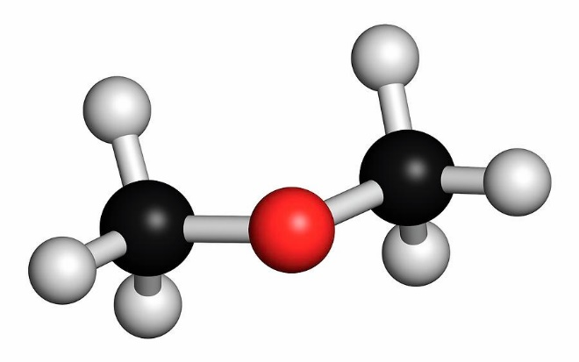
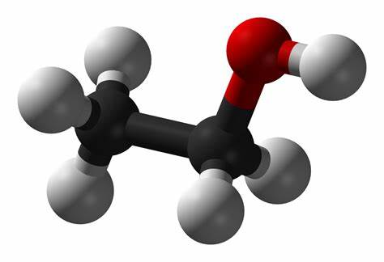
Alcohols and Ethers
- Alcohols have a hydroxyl group (-OH) attached to a carbon atom.
- Ethers contain an oxygen atom linking two carbon atoms.
- Naming conventions follow IUPAC rules.
- Examples: Ethanol, Dimethyl ether

Slide 12
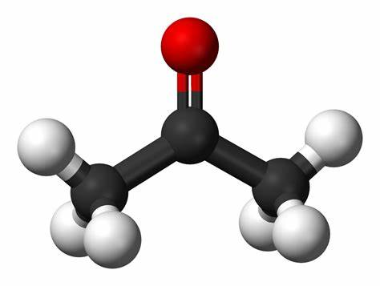
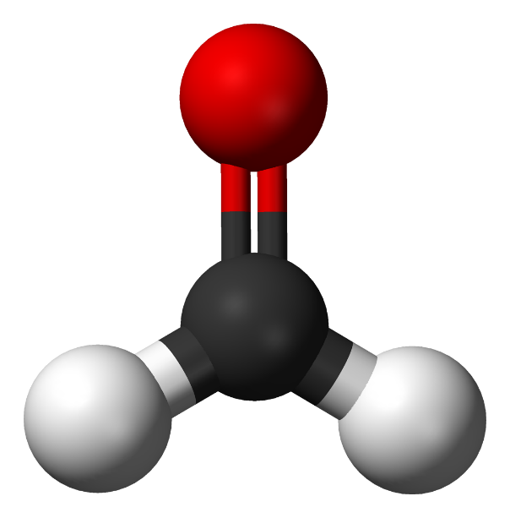
Aldehydes and Ketones
- Aldehydes have a carbonyl group (C=O) at the end of the carbon chain.
- Ketones have a carbonyl group within the carbon chain.
- Naming rules emphasize the position of the carbonyl group.
- Examples: Formaldehyde, Acetone.

Slide 13
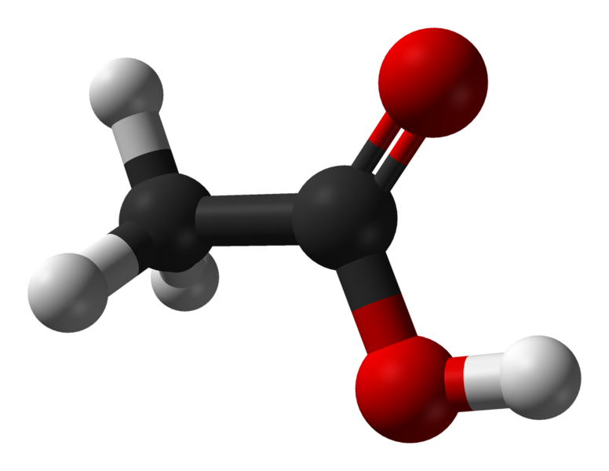
Carboxylic Acids and Esters
- Carboxylic acids contain a carboxyl group (-COOH).
- Esters have an oxygen atom linking a carbonyl and an alkyl group.
- Overview and summary of major organic classes covered.
- Emphasize the importance of nomenclature in distinguishing between these classes.

Slide 14
Thank you

